Slide 1
Online Comparison system
GROUP-3

Slide 2
INTRODUCTION
Tasks that we’ve in this semester
1. IDEA GENERATION
2. USE CASE DIAGRAM
3. ACTIVITY DIAGRAM
4. CLASS DIAGRAM
5. USER STORY CARD
6. UI DESIGN
7. JIRA
8. GIT
9. PROJECT SCHEDULING
10. BUDGETING

Slide 3
Members
Fahim Haider (20-42087-1)
Zishan Ahmed (20-42085-1)
Shakib Sadat Shanto (20-43074-1)
Thouhida Tasnim (20-43051-1)

Slide 4
Idea generation
In online product/service price comparison system a user can view products/services from different stores or shops. He can search products by name or find his desired products by different categories. After searching all appropriate results will come up with product prices and their regarding shops. He can sort the results to find the least price of that product. He can Wishlist or Price-track any product he wants to buy later.

Slide 5
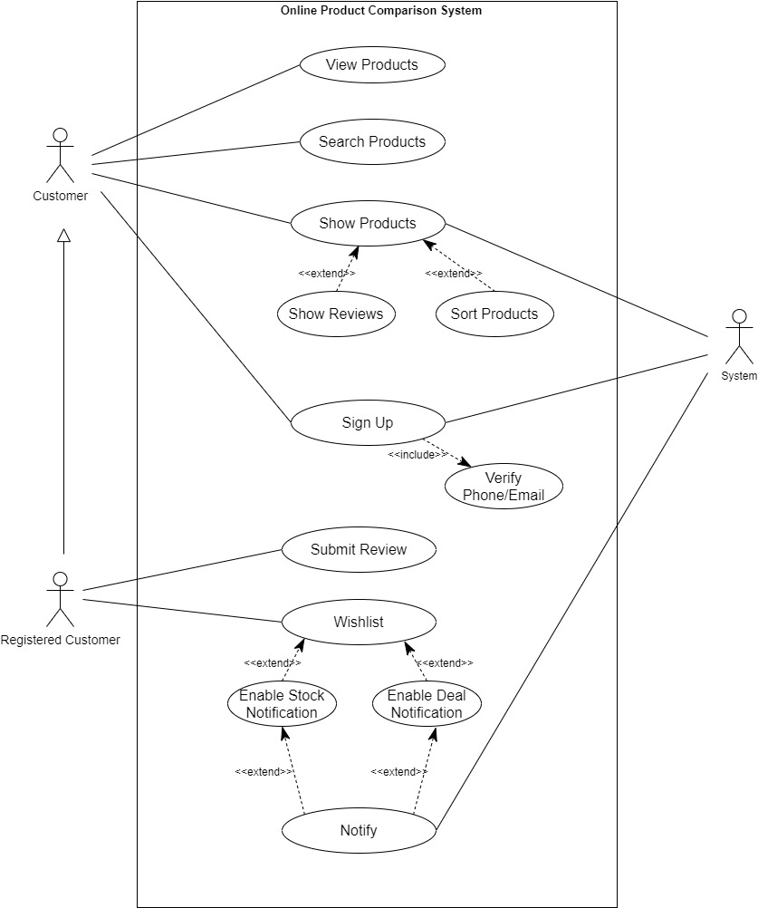
Use case diagram

Slide 6
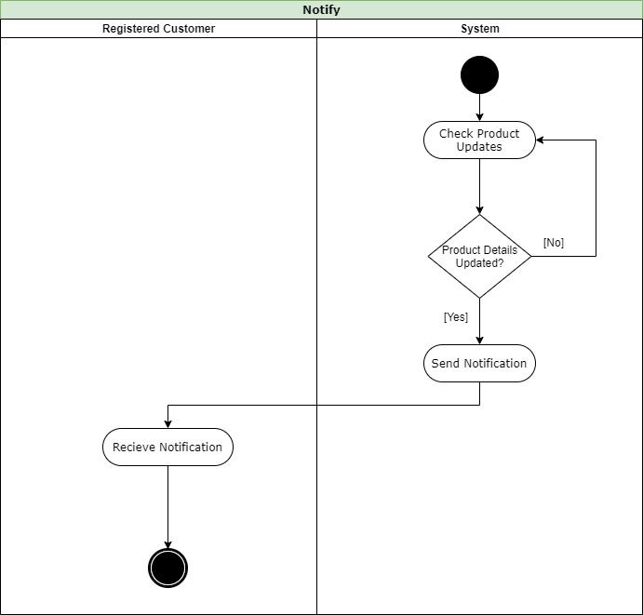
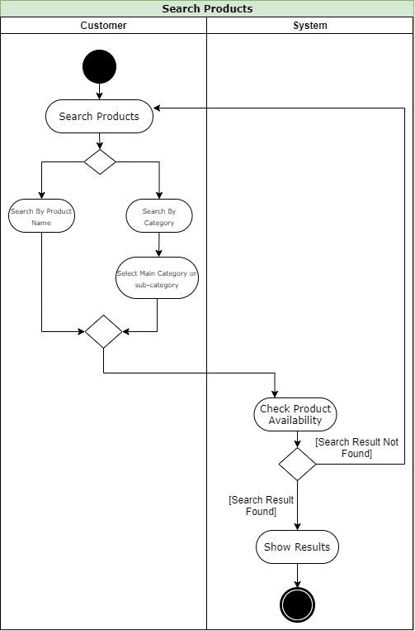
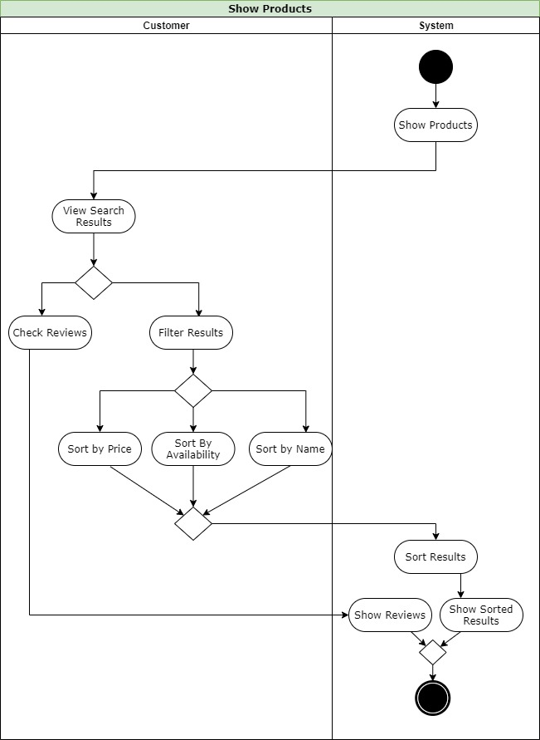
Activity diagram

Slide 7
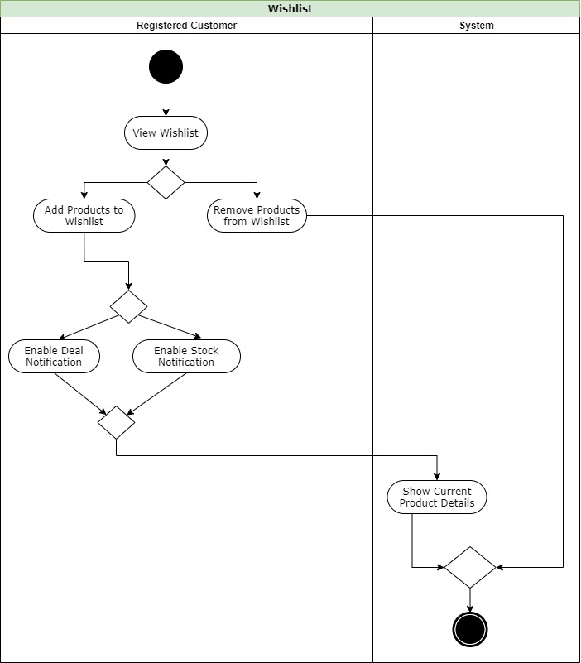
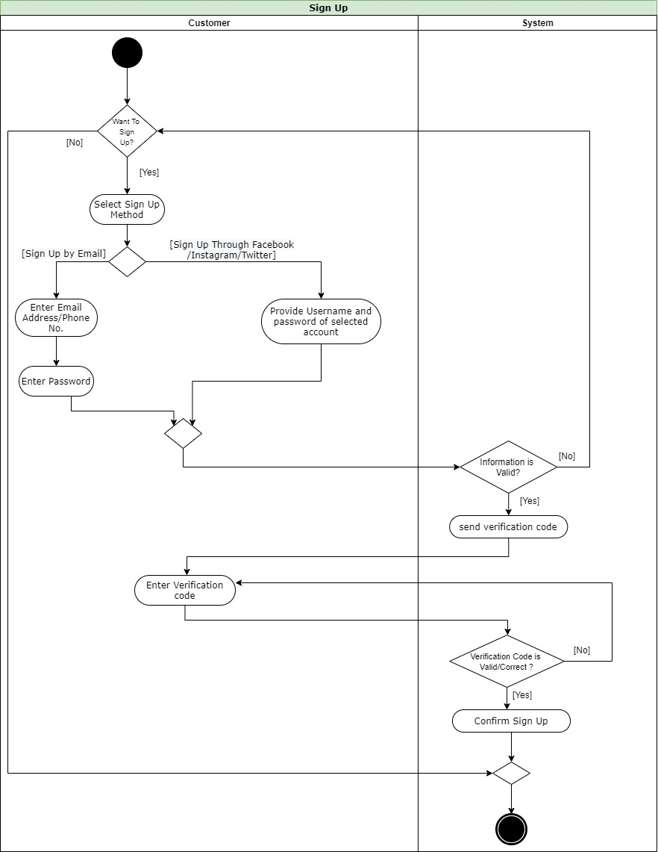
Activity diagram

Slide 8
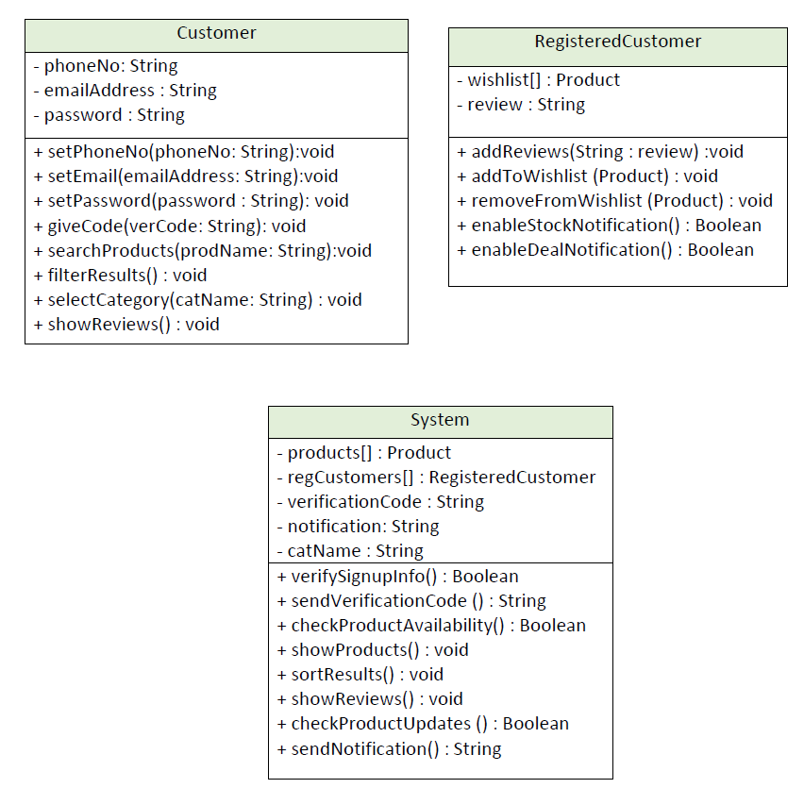
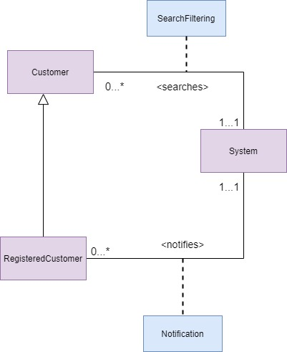
Class diagram

Slide 9
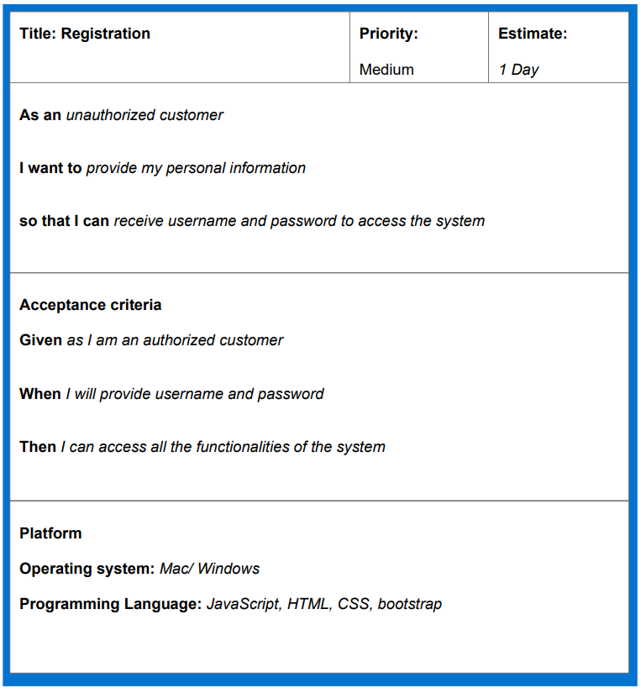
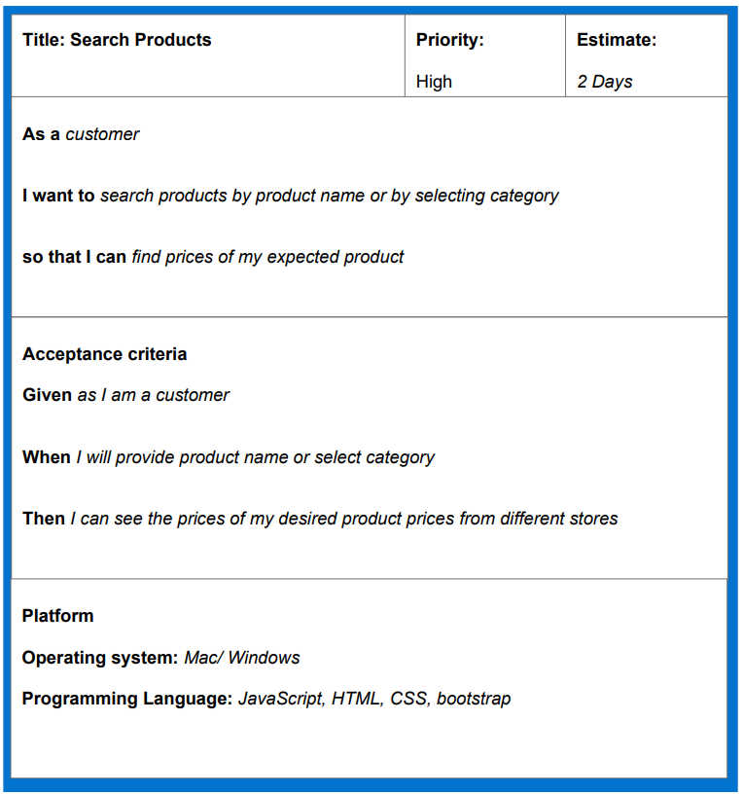
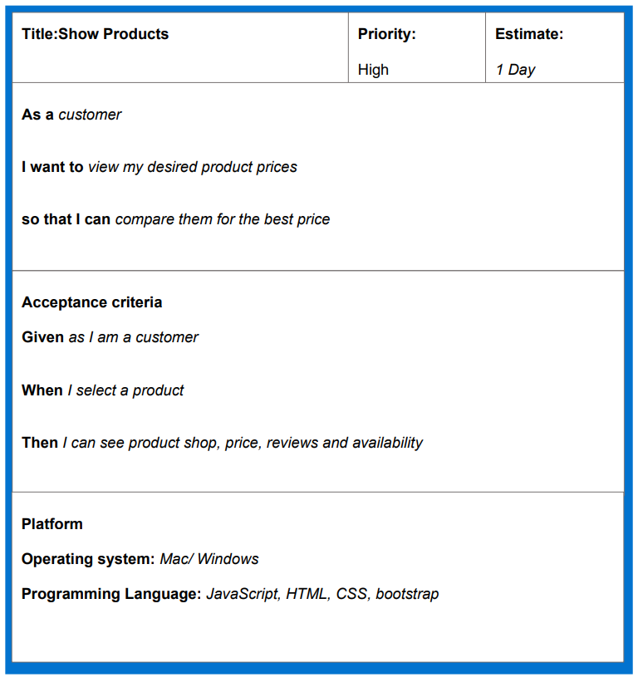
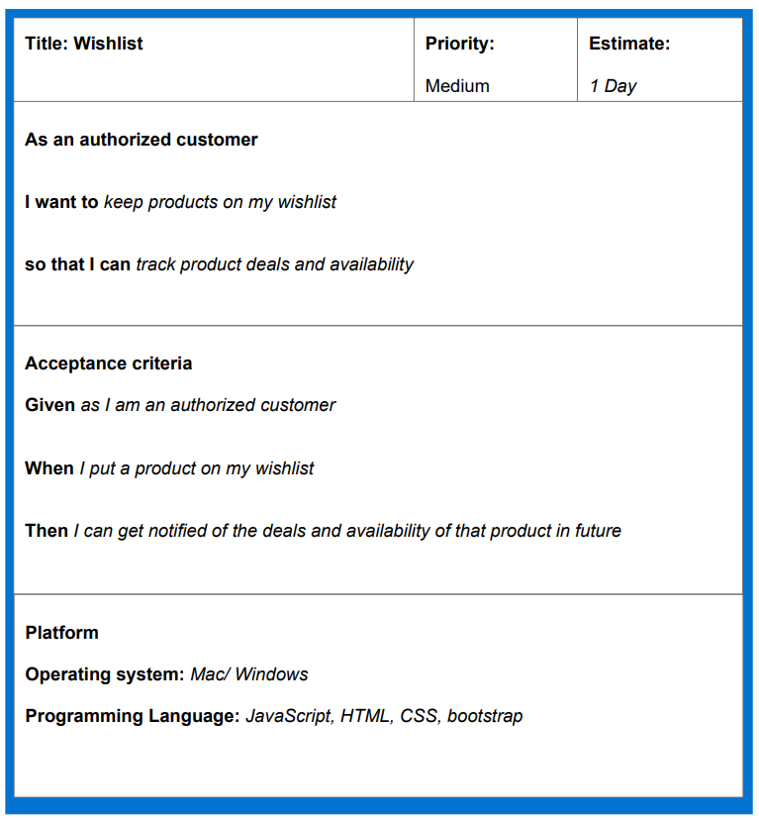
User storycard

Slide 10
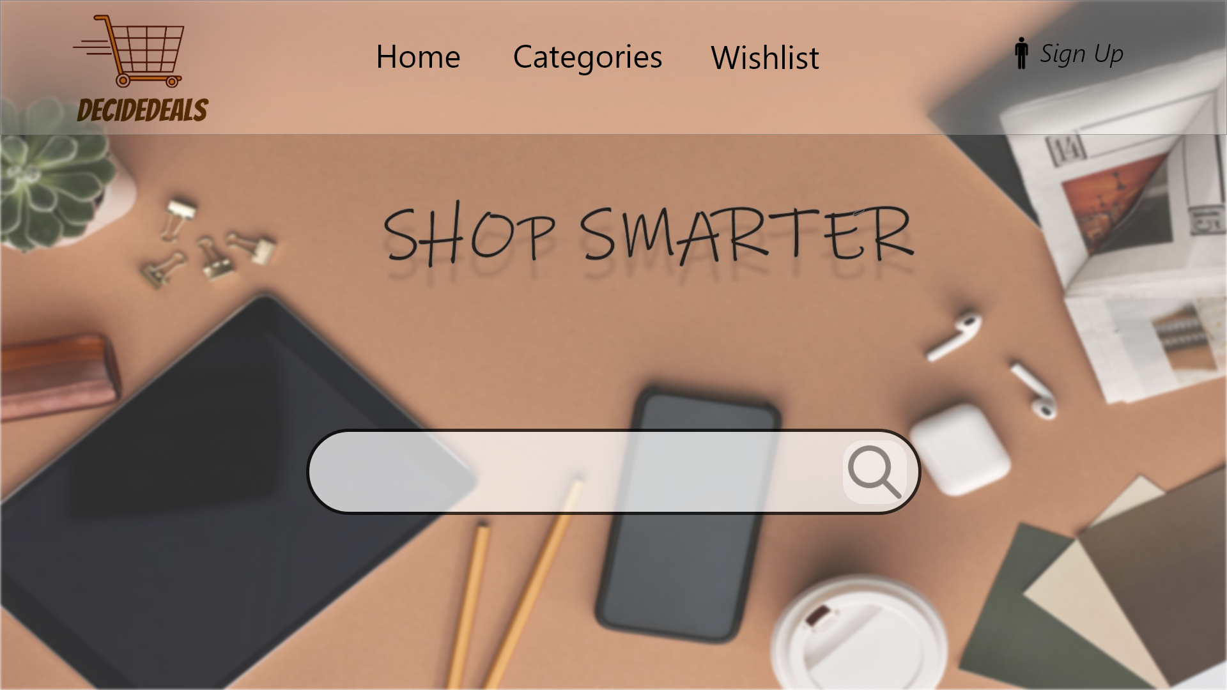
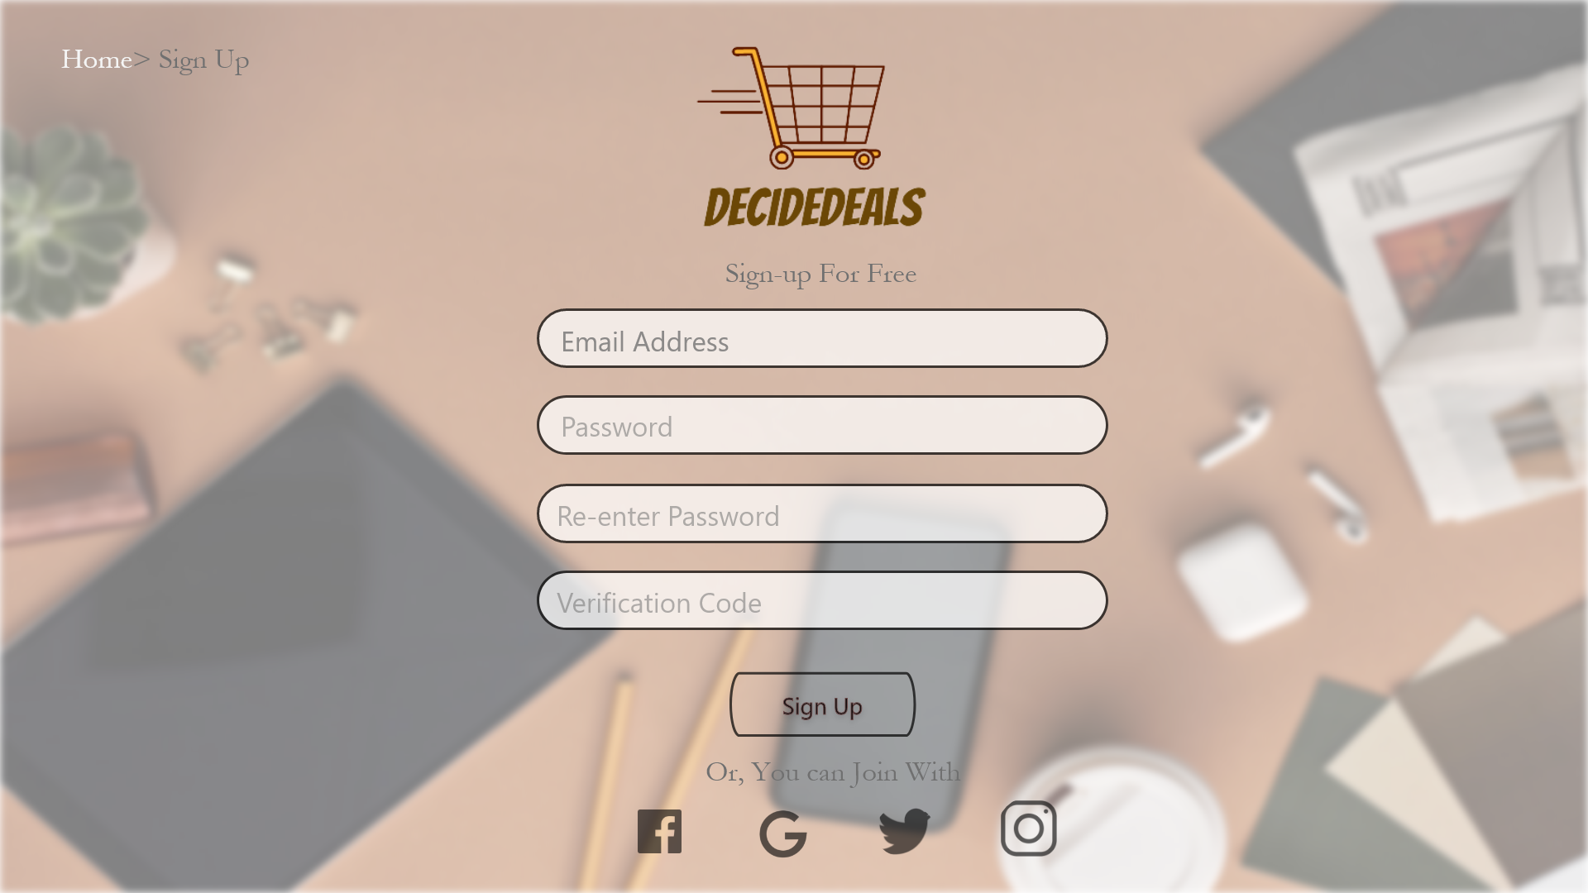

UI design

Slide 11
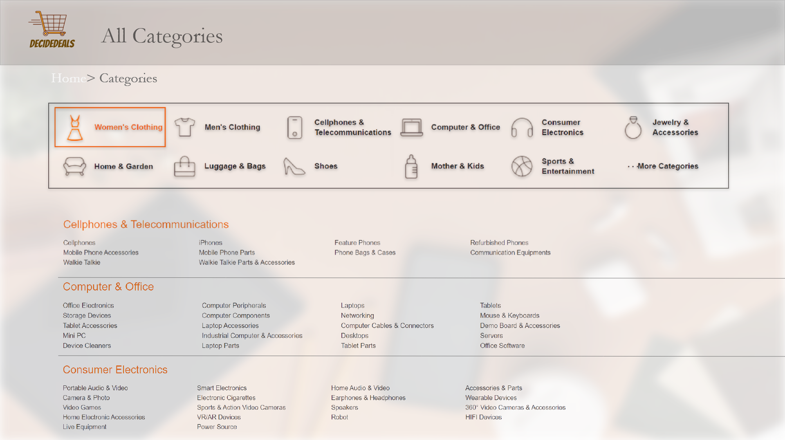
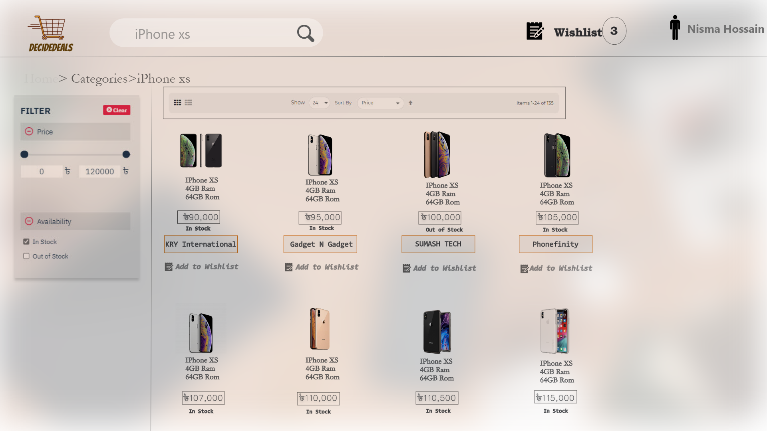
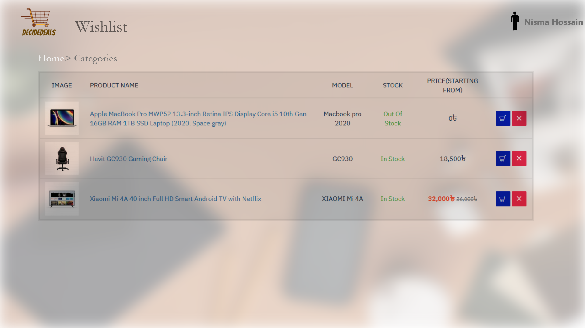
UI design

Slide 12
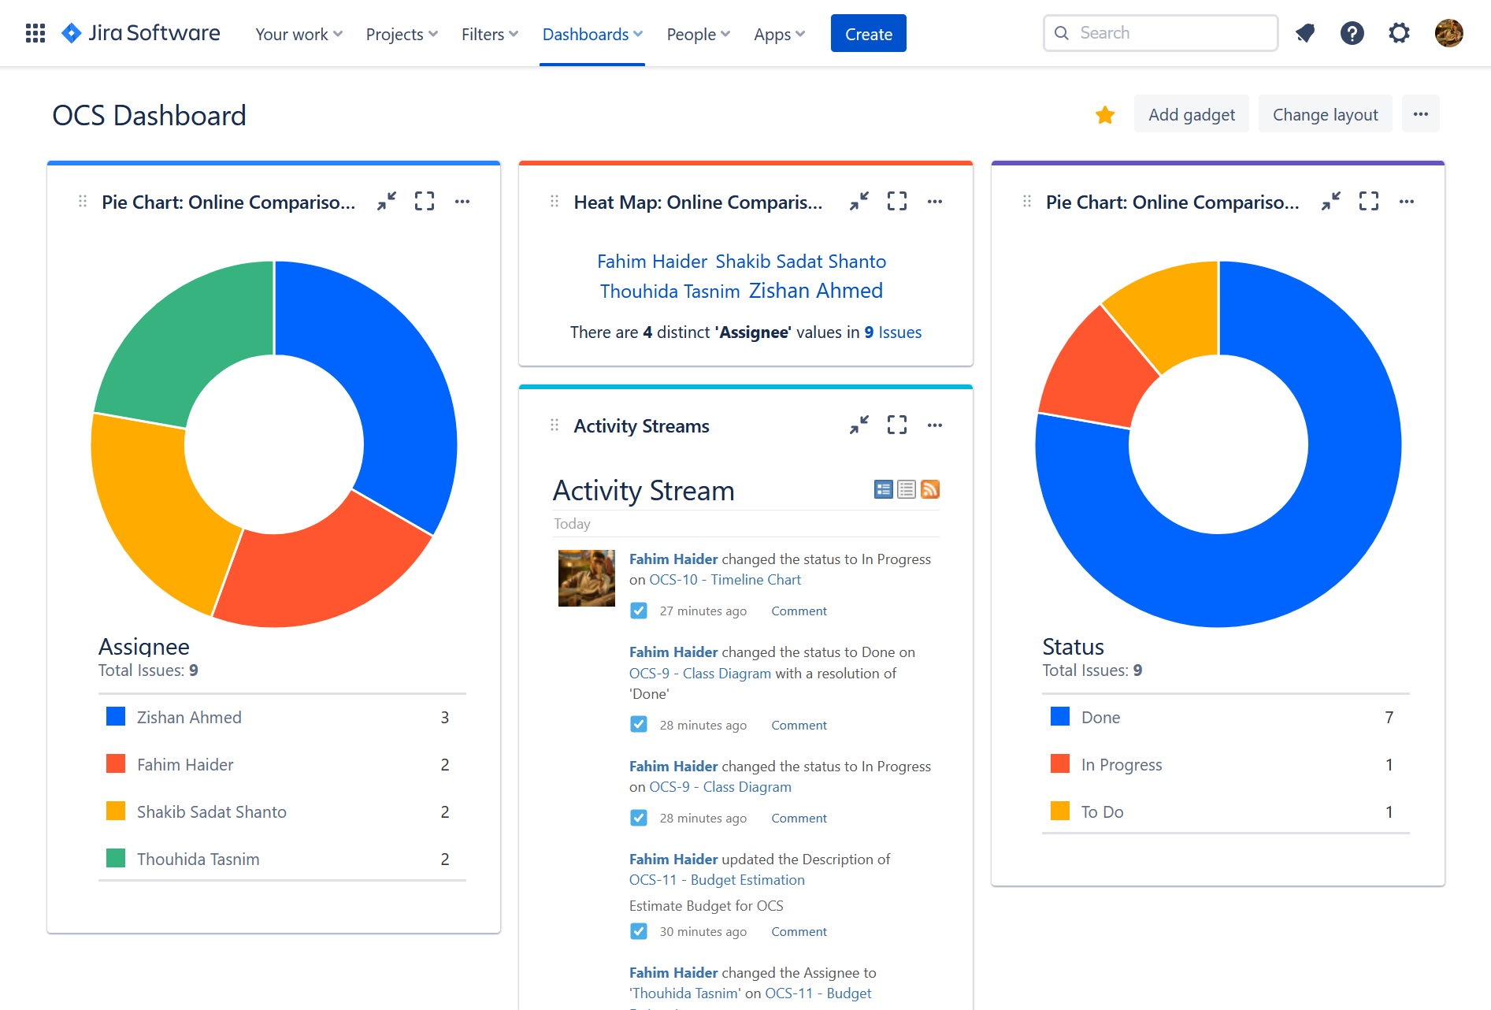
jira

Slide 13
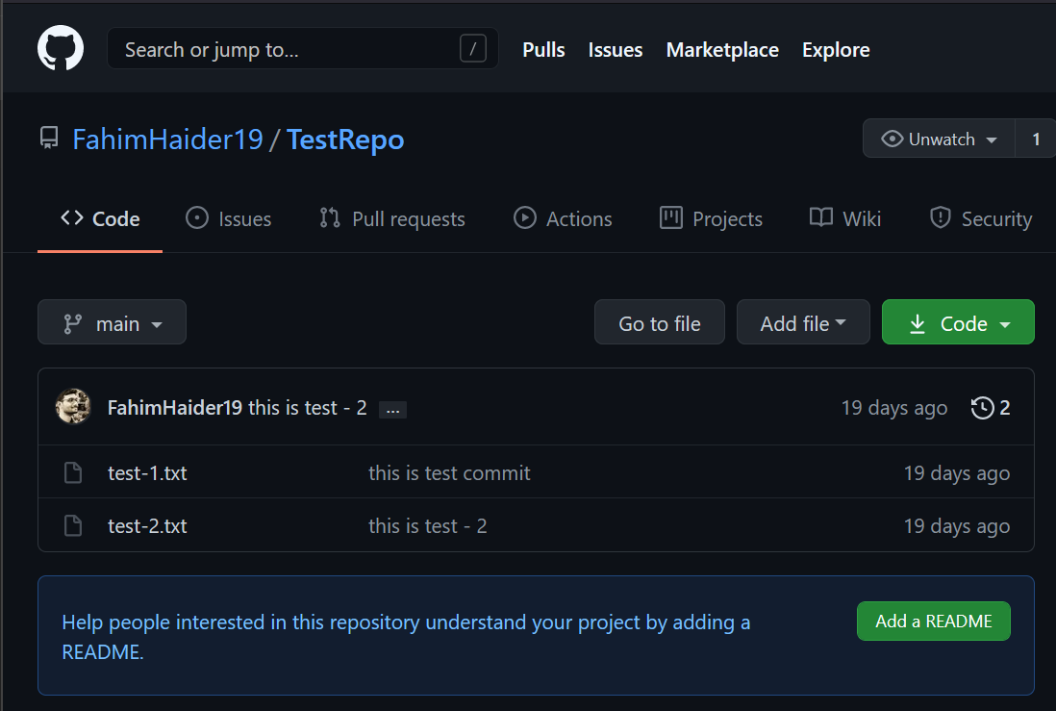
git

Slide 14
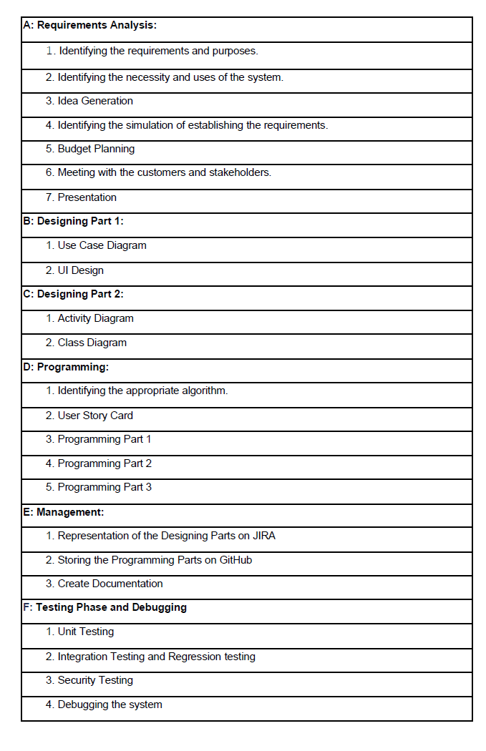
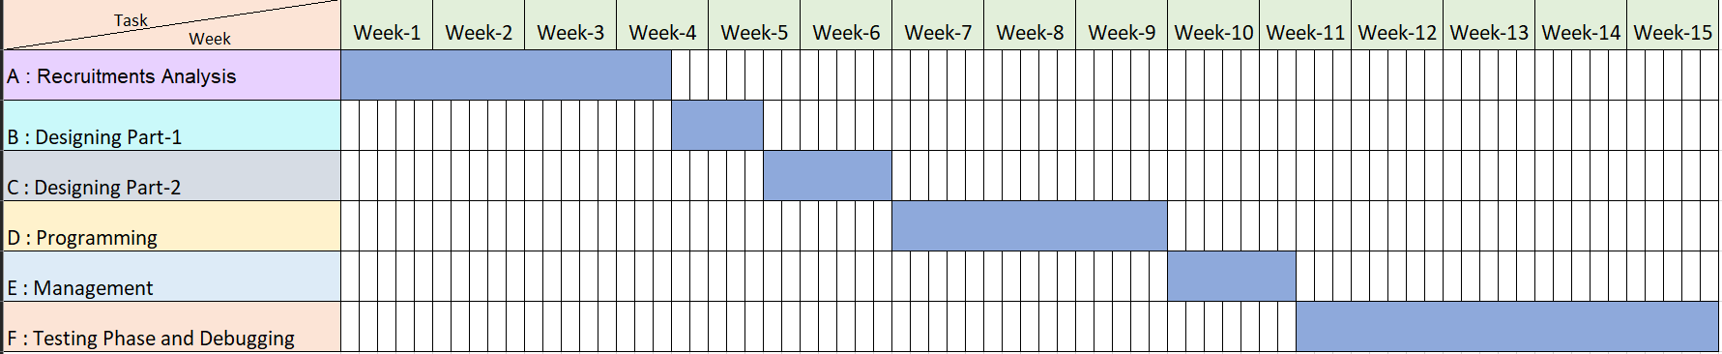
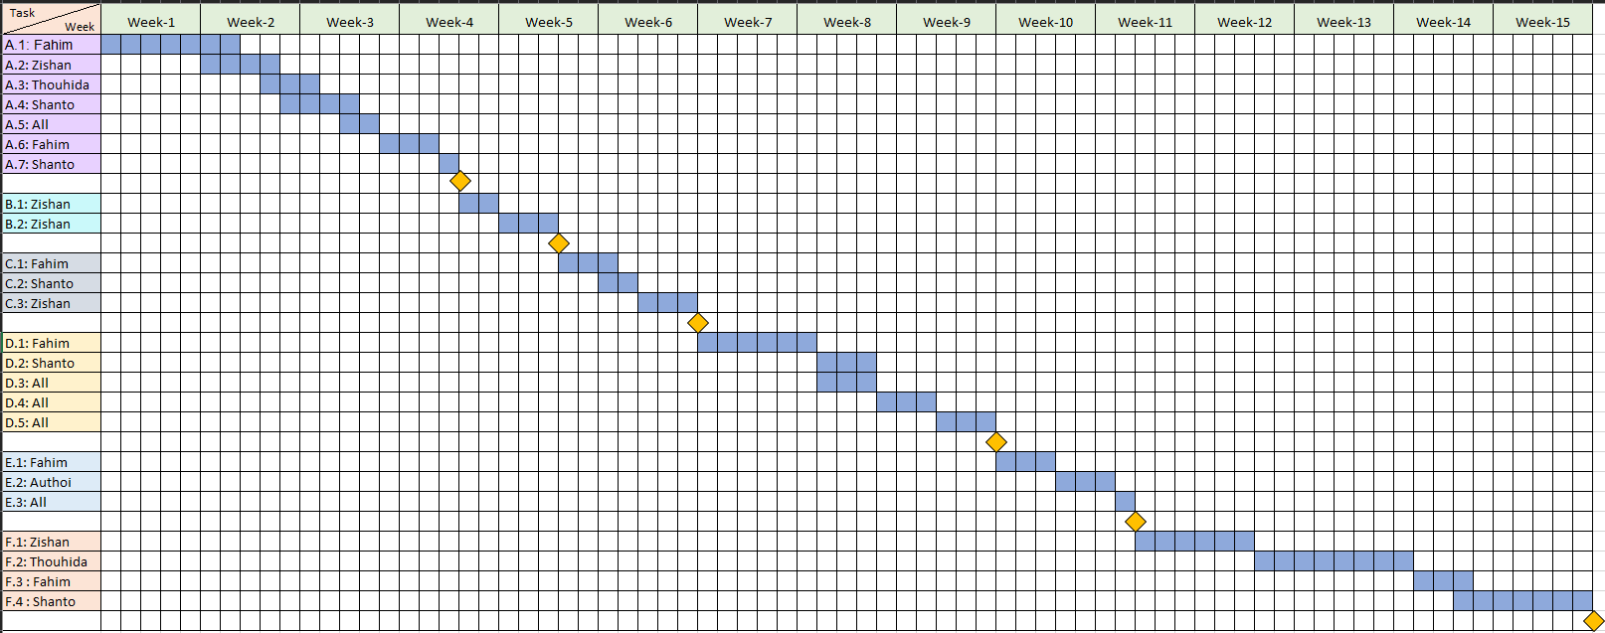
Project scheduling

Slide 15
Budgeting
Costs | Amount
Developer Salary | 15,12000 Taka
Requirement Analysis | 90,000 Taka
Transportation Cost | 10,000 Taka
Training & Hardware Expense | 10,000 Taka
Rent Expense | 90,000 Taka
Total Utilities | 20,000 Taka
Maintenance | 60,000 Taka
Total Estimated Expense | 18,82,000Taka
Profit | 3,76,400 Taka
Project Budget | 22,58,400 Taka
Constructive Cost Model: → Project type : Organic → Coefficient<effort factor> : 2.40 → SLOC : 10000 Lines → Project complexity(P) = 1.05 → SLOC-dependent coefficient(T) = 0.38 → PM: (2.40* 101.05) = 26.93 ≈ 27 → DM: (2.50* 26.930.38) = 8.74
= 9 Months
= 2160 WH → Required People(ST): PM/DM
= 26.93/8.74
= 3.80 ≈ 4

Slide 16
CONCLUSION
Overall, we’ve learnt a lot of things from this project like UI Design, JIRA, GIT, Project Scheduling, Budgeting and lot of other things. Which will help us in managing bigger projects in professional work fields.

Slide 17
Thank you

